Slide 1
Chapter 2: Operating-System Services

Slide 2
Objectives
Identify services provided by an operating system
Illustrate how system calls are used to provide operating system services
Compare and contrast monolithic, layered, microkernel, modular, and hybrid strategies for designing operating systems
Apply tools for monitoring operating system performance
Design and implement kernel modules for interacting with a Linux kernel

Slide 3
Operating System Services
Operating systems provide an environment for execution of programs and services to programs and users
One set of operating-system services provides functions that are helpful to the user:
User interface - Almost all operating systems have a user interface (UI).
Command-Line (CLI), Graphics User Interface (GUI), touch-screen, Batch
Program execution - The system must be able to load a program into memory and to run that program, end execution, either normally or abnormally (indicating error)
I/O operations - A running program may require I/O, which may involve a file or an I/O device
File-system manipulation - The file system is of particular interest. Programs need to read and write files and directories, create and delete them, search them, list file Information, permission management.

Slide 4
Operating System Services (Cont.)
Communications – Processes may exchange information, on the same computer or between computers over a network
Communications may be via shared memory or through message passing (packets moved by the OS)
Error detection – OS needs to be constantly aware of possible errors
May occur in the CPU and memory hardware, in I/O devices, in user program
For each type of error, OS should take the appropriate action to ensure correct and consistent computing.
might terminate an error-causing process
Sometimes, it has no choice but to halt the system.
Debugging facilities can greatly enhance the user’s and programmer’s abilities to efficiently use the system

Slide 5
Operating System Services (Cont.)
Another set of OS functions exists for ensuring the efficient operation of the system itself via resource sharing
Resource allocation - When multiple users or multiple jobs running concurrently, resources must be allocated to each of them
Many types of resources - CPU cycles, main memory, file storage, I/O devices.
Logging - To keep track of which users use how much and what kinds of computer resources
Protection and security - The owners of information stored in a multiuser or networked computer system may want to control use of that information, concurrent processes should not interfere with each other

Slide 6
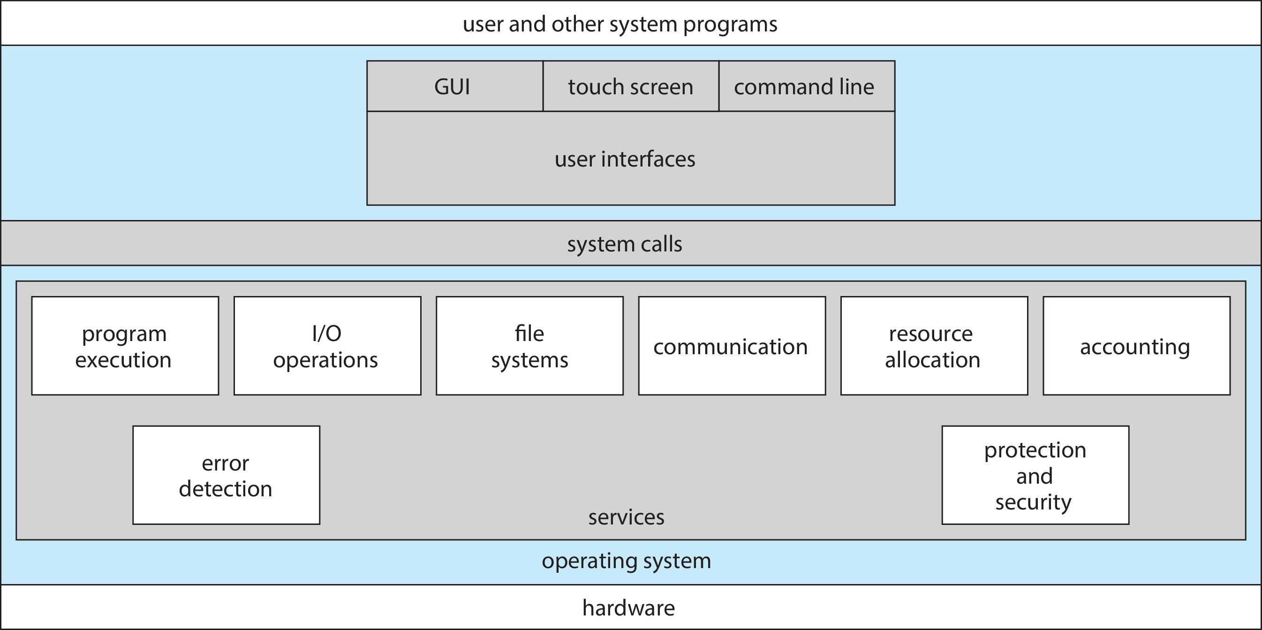
A View of Operating System Services

Slide 7
Command Line interpreter
Command interpreter as a special program that is running when a process is initiated or when a user first logs on
C shell, Bourne-Again (bash) shell, Korn shell
CLI allows direct command entry
Sometimes implemented in kernel, sometimes by systems program
Sometimes multiple flavors implemented – shells
Primarily fetches a command from user and executes it
Sometimes commands built-in, sometimes just names of programs
For built-in, CI jumps to the section and make a system call.
If the latter, adding new features doesn’t require shell modification.

Slide 8
User Operating System Interface - GUI
User-friendly desktop metaphor interface
Usually mouse, keyboard, and monitor
Icons represent files, programs, actions, etc
Various mouse buttons over objects in the interface cause various actions (provide information, options, execute function, open directory i.e., folder)
Invented in the early 1970s at Xerox PARC research facility
The first GUI appeared on the Xerox Alto computer in 1973
Many systems now include both CLI and GUI interfaces (Why??)
Microsoft Windows is GUI with CLI “command” shell
Apple Mac OS X is “Aqua” GUI interface with UNIX kernel underneath and shells available
Unix and Linux have CLI with optional GUI interfaces (CDE, KDE, GNOME)

Slide 9

Touchscreen Interfaces
Touchscreen devices require new interfaces
Mouse not possible or not desired
Actions and selection based on gestures
Virtual keyboard for text entry
Voice commands

Slide 10
System Calls
Programming interface to the services provided by the OS
Typically written in a high-level language (C or C++)
certain low-level tasks may be written using assembly-language instructions
Mostly accessed by programs via a high-level Application Programming Interface (API) rather than direct system call use
Three most common APIs are Win32 API for Windows, POSIX API for POSIX-based systems (including virtually all versions of UNIX, Linux, and Mac OS X), and Java API for the Java virtual machine (JVM)

Slide 11
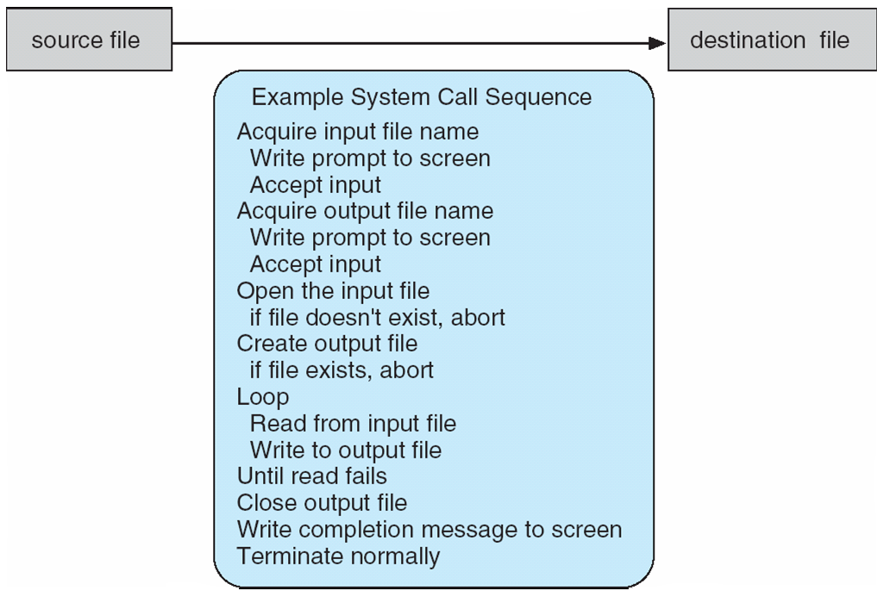
Example of System Calls
System call sequence to copy the contents of one file to another file
cp in.txt out.txt
systems execute thousands of system calls per second
programmers never see this level of detail and use APIs.

Slide 12
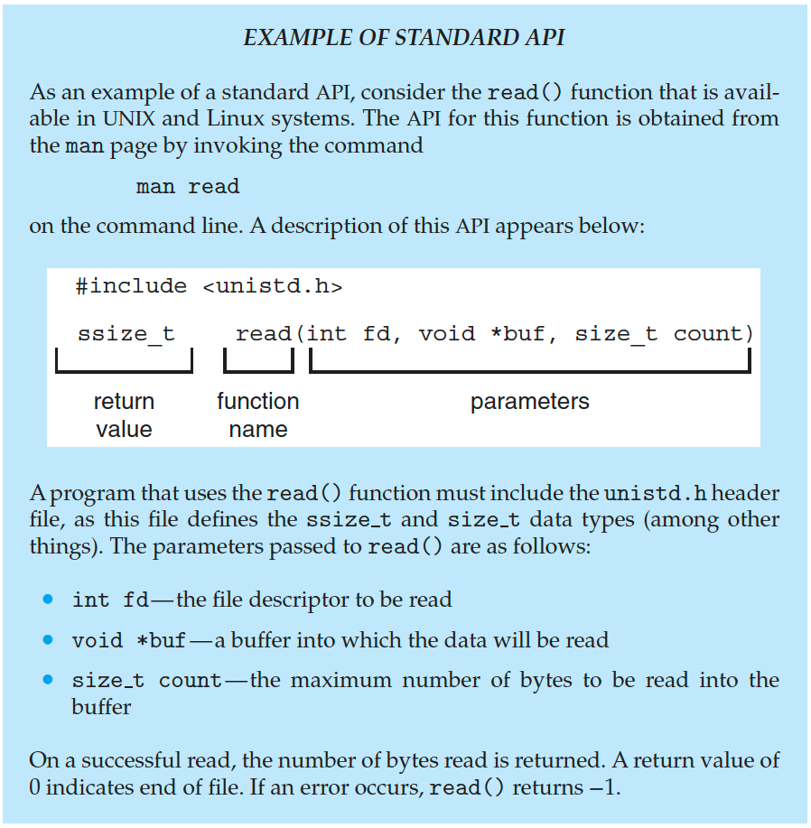
Example of Standard API

Slide 13
System Call Implementation
Typically, a number is associated with each system call
System-call interface maintains a table indexed according to these numbers
The system call interface invokes the intended system call in OS kernel and returns status of the system call and any return values
The caller need know nothing about how the system call is implemented
Just needs to obey API and understand what OS will do as a result call
Most details of OS interface hidden from programmer by API
Managed by run-time support library (set of functions built into libraries included with compiler)

Slide 14

API – System Call – OS Relationship

Slide 15
System Call Parameter Passing
Often, more information is required than simply identity of desired system call
Exact type and amount of information vary according to OS and call
Why parameter passing?
Three general methods used to pass parameters to the OS
Simplest: pass the parameters in registers
In some cases, may be more parameters than registers
Parameters stored in a block, or table, in memory, and address of block passed as a parameter in a register
This approach taken by Linux and Solaris
Parameters placed, or pushed, onto the stack by the program and popped off the stack by the operating system
Block and stack methods do not limit the number or length of parameters being passed

Slide 16
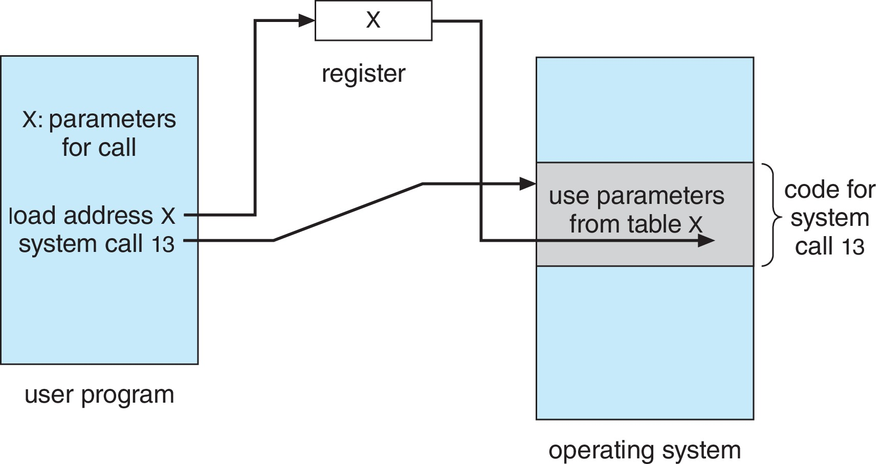
Parameter Passing via Table

Slide 17
Types of System Calls
Process control
create process create_process(), terminate process terminate process()
end, abort
load, execute
get process attributes, set process attributes
wait for time
wait event, signal event
allocate and free memory

Slide 18
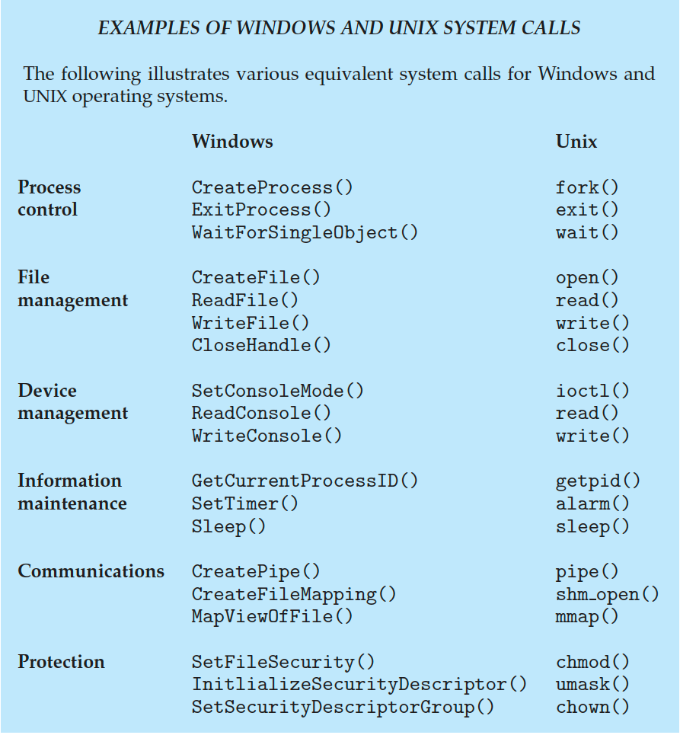
Examples of Windows and Unix System Calls

Slide 19
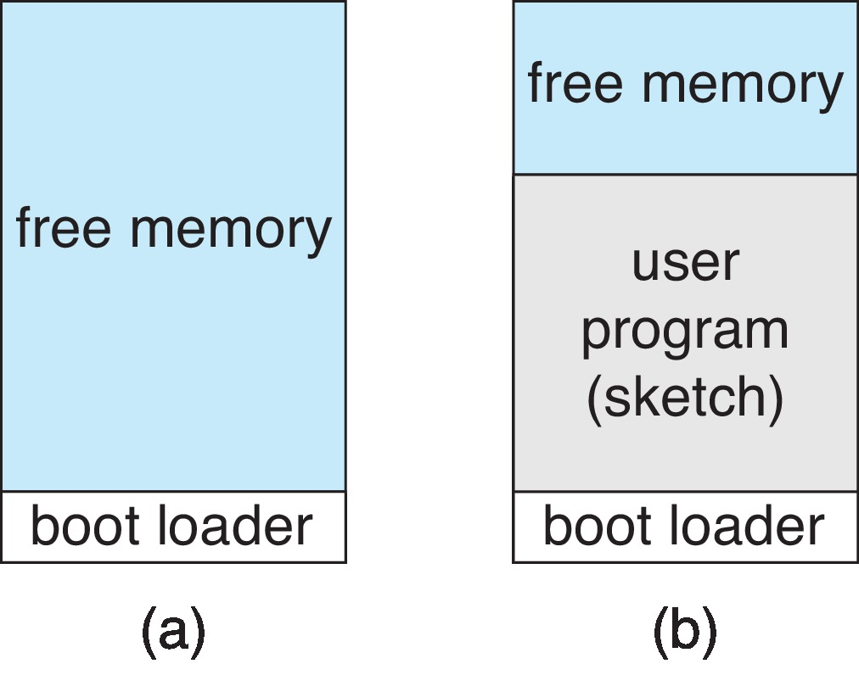
Example: Arduino
Arduino is a simple hardware platform consisting of a microcontroller along with input sensors that respond to a variety of events.
the Arduino provides no user interface beyond hardware input sensors.
Single-tasking
No operating system
Boot loader loads program
Programs (sketch) loaded via USB into flash memory
Single memory space
Program exit -> shell reloaded
At system startup running a program

Slide 20
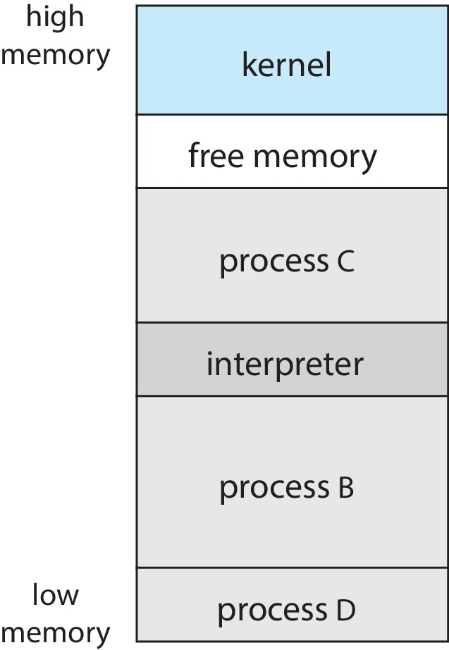
Example: FreeBSD
Unix variant
Multitasking
User login -> invoke user’s choice of shell
Shell executes fork() system call to create process
Executes exec() to load program into memory
Depending on how the command was issued,
the shell either waits for the process to finish
or runs the process “in the background.”
Process exits with:
code = 0 – no error
code > 0 – error code

Slide 21
Linkers and Loaders
Source code compiled into object files designed to be loaded into any physical memory location – relocatable object file
Linker combines these into single binary executable file
Also brings in libraries
Program resides on secondary storage as binary executable
Must be brought into memory by loader to be executed
Relocation assigns final addresses to program parts and adjusts code and data in program to match those addresses
Modern general purpose systems don’t link libraries into executables
Rather, dynamically linked libraries (in Windows, DLLs) are loaded as needed, shared by all that use the same version of that same library (loaded once)

Slide 22
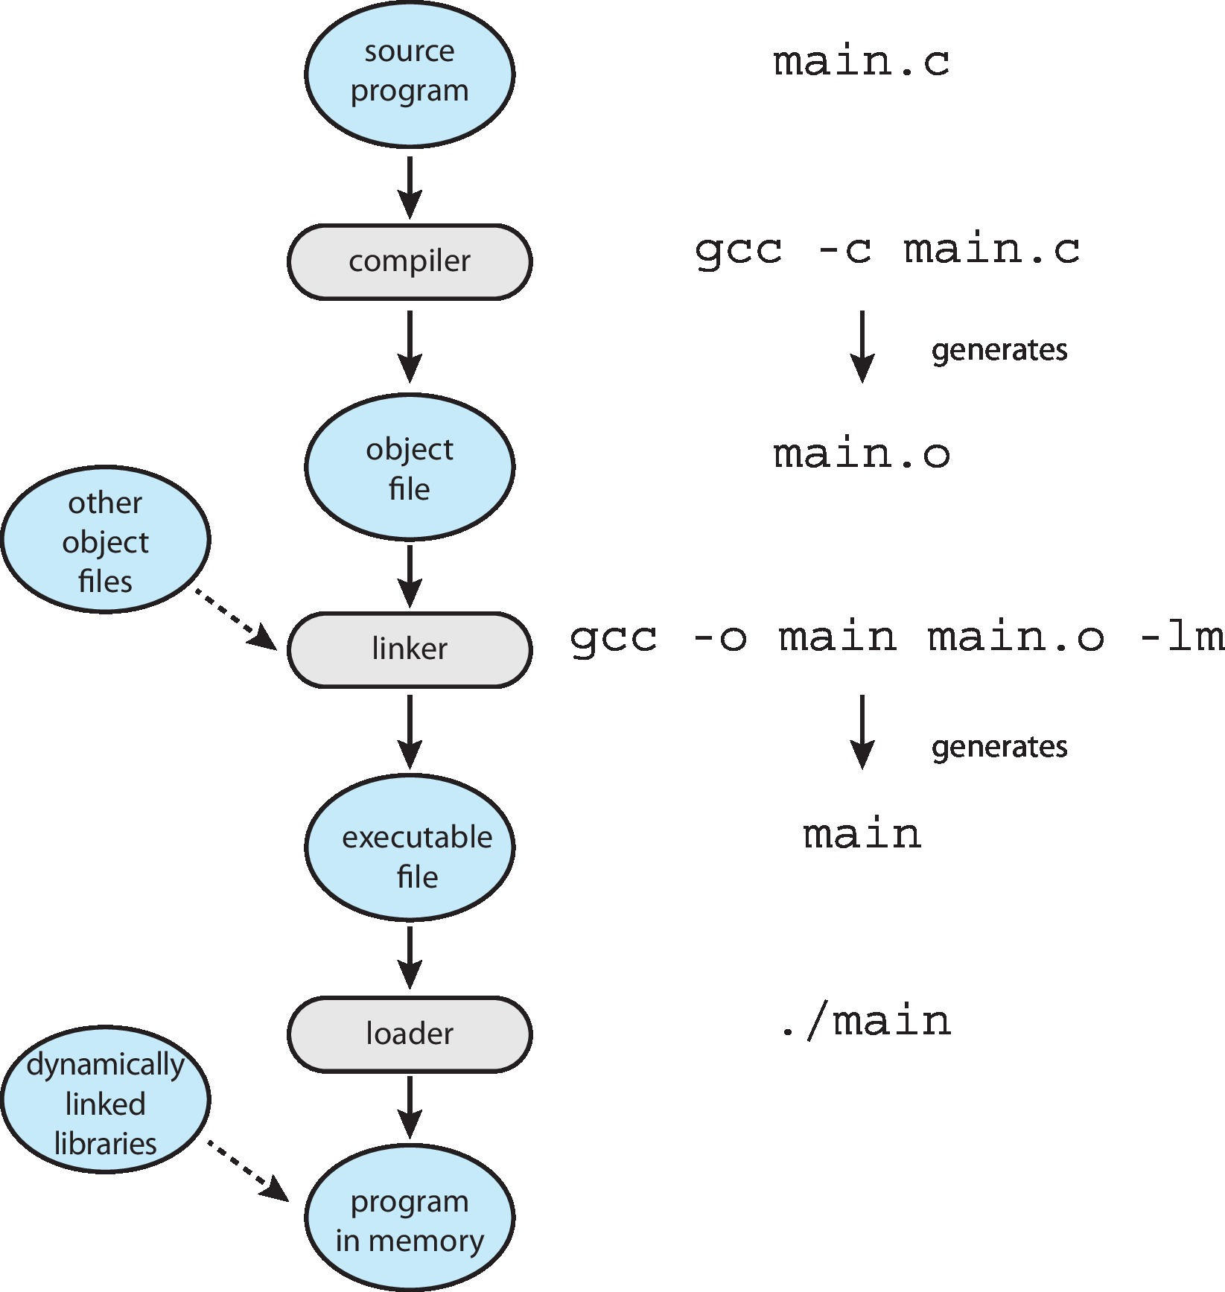
The Role of the Linker and Loader

Slide 23
Why Applications are Operating System Specific
Apps compiled on one system usually not executable on other operating systems
Each operating system provides its own unique system calls
Own file formats, etc.
Apps can be multi-operating system
Written in interpreted language like Python, Ruby, and interpreter available on multiple operating systems
interpreter provides only a subset of each operating system’s features. Thus, performance suffers relative to that for native applications
App written in language that includes a VM containing the running app (like Java)
Use standard language (like C), compile separately on each operating system to run on each
unless an interpreter, VM, or binary executable file is written for and compiled on a specific OS on a specific CPU type, the app will fail to run.
Is cross-platform applications development is easy task?

Slide 24
Design and Implementation
Design and Implementation of OS is not “solvable”,
Internal structure of different Operating Systems can vary widely
but some approaches have proven successful
Start the design by defining goals and specifications
Affected by choice of hardware, type of system
User goals and System goals
User goals – operating system should be convenient to use, easy to learn, reliable, safe, and fast
System goals – operating system should be easy to design, implement, and maintain, as well as flexible, reliable, error-free, and efficient
Specifying and designing an OS is highly creative task of software engineering

Slide 25
Policy and Mechanism
Important design principle: Separation of policy from mechanism
Policy: What needs to be done?
Example: Interrupt after every 100 seconds
Mechanism: How to do?
Example: timer
The separation of policy from mechanism is a very important principle, it allows maximum flexibility if policy decisions are to be changed later.
Example: change 100 to 200
CPU Scheduling
Bad Design
Process* select_next_process() {
// Implements Round Robin with 100ms quantum
}
Good design Process* select_next_process() {
return policy_func(ready_queue, FCFS);
}

Slide 26
Implementation
Operating systems are collections of many programs, written by many people over a long period of time
Much variation
Early OSes in assembly language; Now C, C++
Actually usually a mix of languages; Example Android
Kernel is written mostly in C with some assembly language
system libraries are written in C or C++
application frameworks, which provide the developer interface to the system, are written mostly in Java
More high-level language (because of interpreter) easier to port to other hardware
But slower

Slide 27
Operating System Structure

Slide 28
Monolithic Structure – Original UNIX
The simplest structure for organizing an operating system is no structure at all.
place all of the functionality of the kernel into a single, static binary file that runs in a single address space. (Any Advantage ??)
The UNIX OS consists of two separable parts
Systems programs
The kernel
Consists of everything below the system-call interface and above the physical hardware
Provides the file system, CPU scheduling, memory management, and other operating-system functions; a large number of functions for one level

Slide 29

Traditional UNIX System Structure
simple but not fully layered and difficult to extend.

Slide 30

Linux System Structure
Monolithic plus modular design
The Linux kernel runs entirely in kernel mode in a single address space

Slide 31

Layered Approach
monolithic approach->tightly coupled
changes to one part of the system can have wide-ranging effects on other parts.
The OS is divided into a number of layers (levels), each built on top of lower layers. The bottom layer (layer 0), is the hardware; the highest (layer N) is the user interface.
With modularity, layers are selected such that each uses functions (operations) and services of only lower-level layers
layer M—consists of data structures and a set of functions that can be invoked by higher-level layers. Layer M, in turn, can invoke operations on lower-level layers.
Simplicity of construction and debugging
Not used for full design; used within several important OS subsystems e.g., networking

Slide 32
Microkernels
Theme: Moves as much from the kernel into user space
Mach is an example of microkernel
Mac OS X kernel (Darwin) partly based on Mach
Communication takes place between user modules using message passing
Benefits:
Easier to extend a microkernel (All new services are added to user space)
Easier to port the operating system to new architectures
More reliable (less code is running in kernel mode)
More secure (most services are running as user)
Detriments:
Performance overhead of user space to kernel space communication

Slide 33
Microkernel System Structure
Microkernel is to provide communication between the client program and the various services that are also running in user space.

Slide 34
Modules
Many modern operating systems implement loadable kernel modules (LKMs)
Uses object-oriented approach
Each core component is separate
Each talks to the others over known interfaces
Each is loadable as needed within the kernel
This type of design is common in modern implementations of UNIX, such as Linux, macOS, and Solaris, as well as Windows.
Overall, similar to layers but with more flexible

Slide 35
Hybrid Systems
Most modern operating systems are not one pure model
Hybrid combines multiple approaches to address performance, security, usability needs
Linux and Solaris kernels in kernel address space, so monolithic, plus modular for dynamic loading of functionality
Windows mostly monolithic, plus microkernel for different subsystem personalities
Apple Mac OS X hybrid
Below is kernel consisting of Mach microkernel and BSD Unix parts, plus I/O kit and dynamically loadable modules (called kernel extensions)

Slide 36
macOS and iOS Structure
Read by yourself

Slide 37
Darwin
Read by yourself

Slide 38
Android
Read by yourself

Slide 39
Building and Booting an Operating System
Operating systems generally designed to run on a class of systems with variety of peripherals
Commonly, operating system already installed on purchased computer
But can build and install some other operating systems
If generating an operating system from scratch
Write the operating system source code
Configure the operating system for the system on which it will run
Compile the operating system
Install the operating system
Boot the computer and its new operating system

Slide 40
Building and Booting Linux
Download Linux source code (http://www.kernel.org)
Configure kernel via “make menuconfig”
Compile the kernel using “make”
Produces vmlinuz, the kernel image
Compile kernel modules via “make modules”
Install kernel modules into vmlinuz via “make modules_install”
Install new kernel on the system via “make install”

Slide 41
Operating-System Debugging
Debugging is finding and fixing errors, or bugs
Also performance tuning
OS generate log files containing error information
Failure of an application can generate core dump file capturing memory of the process
Operating system failure can generate crash dump file containing kernel memory
Beyond crashes, performance tuning can optimize system performance
Sometimes using trace listings of activities, recorded for analysis
Profiling is periodic sampling of instruction pointer to look for statistical trends

Slide 42
Performance Tuning
Improve performance by removing bottlenecks
OS must provide means of computing and displaying measures of system behavior
For example, Windows Task Manager

Slide 43
Tracing
Collects data for a specific event, such as steps involved in a system call invocation
Tools include
strace – trace system calls invoked by a process
gdb – source-level debugger
perf – collection of Linux performance tools
tcpdump – collects network packets

Slide 44

BCC
Debugging interactions between user-level and kernel code nearly impossible without toolset that understands both an instrument their actions
BCC (BPF Compiler Collection) is a rich toolkit providing tracing features for Linux
For example, disksnoop.py traces disk I/O activity

Slide 45
Linux bcc/BPF Tracing Tools

Slide 46
End of Chapter 2

